Slide 1
RFID TEAM 2: RFID WEATHER STATION
Manish Balakrishnan, Ryan Bloomgren, Bradley Clemente, Ryan Ryan Bajollari

Slide 2
Outline
Abstract
Project Architecture
Team Contributions
Hardware
Software Components
Firebase database
Weather Station Mobile App
Notes:
Bradley C

Slide 3
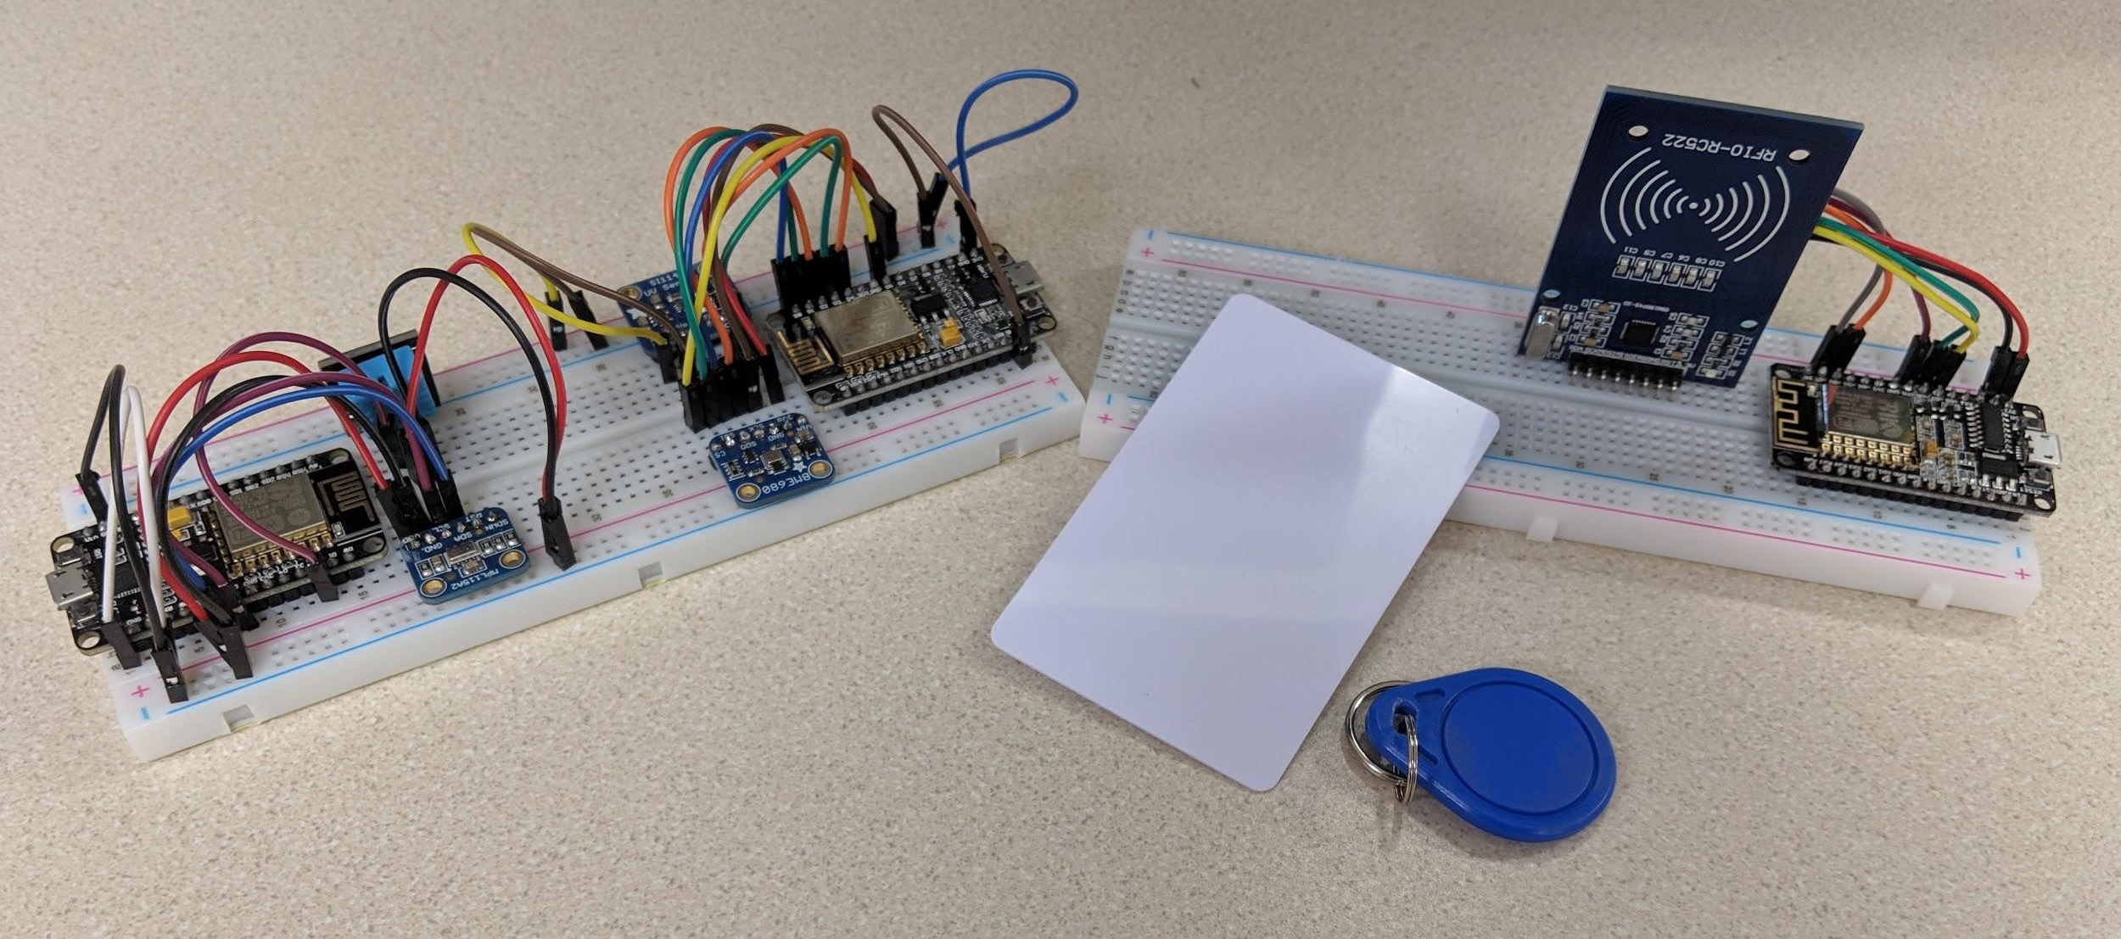
Project Abstract
Create a system such that one can monitor different locations’ weather data from one central location
Allows one to have multiple subsystems report to one central person/location
Notes:
Bradley Clemente

Slide 4


Overview of Project Architecture
Idea is that there is one master ESP8266 wired to an RFID reader and two station ESP8266s all connected to a firebase database through WiFi
Each station ESP8266 has access to various telemetric data (humidity, temperature, pressure, UV index, altitude, foreign gasses)
As user swipes RFID, the database is updated with the ping
The corresponding slave, while monitoring the database then starts transmitting data from its sensor to the database
The phone app then pulls data from the firebase
Master ESP8266 with RFID Scan
Phone app
Firebase
Station 1 ESP8266 with telemetry
Station 2 ESP8266 with telemetry
Notes:
Bradley Clemente

Slide 5
Team contributions
Name | Contribution
Bradley Clemente | Developed RFID Reader code and implemented Firebase
Manish Balakrishnan | Developed Weatherstation code to send to Firebase
Ryan Bloomgren | Developed Weatherstation code to gather sensor data
Ryan Bajollari | Created mobile app to display data
Notes:
Bradley Clemente

Slide 6
Hardware Components
The following hardware were used:
ESP8266 Master:
MFRC522 (SPI bus connection): RFID Reader
ESP8266 Station 1:
BME680 (SPI bus connection): Temperature, Humidity, Pressure, Approx. Altitude and Gas Sensor
SI1145 (I2C connection): UV sensor
ESP8266 Station 2:
MPL115A2 (I2C connection): Barometric Pressure/Temperature Sensor
DHT11: Humidity Sensor
Notes:
Manish Balakrishnan

Slide 7
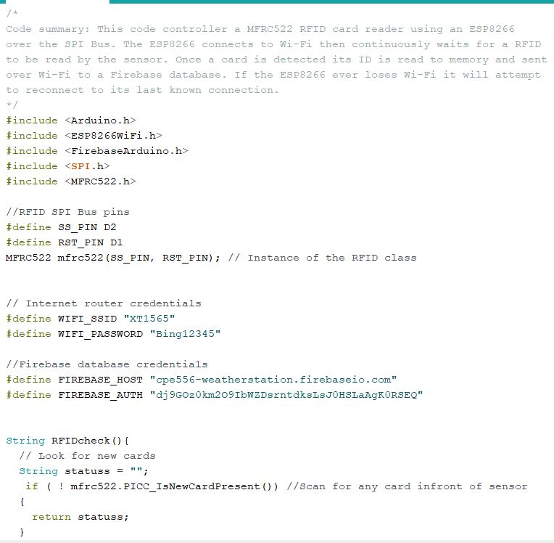
Software - Master
Master ESP8266 programmed in Arduino IDE, using C++
Instantiates WiFi and Firebase database credentials
Checks if an RFID is scanned
If scanned, sends the station ID to Firebase over WiFi
Notes:
Manish Balakrishnan

Slide 8
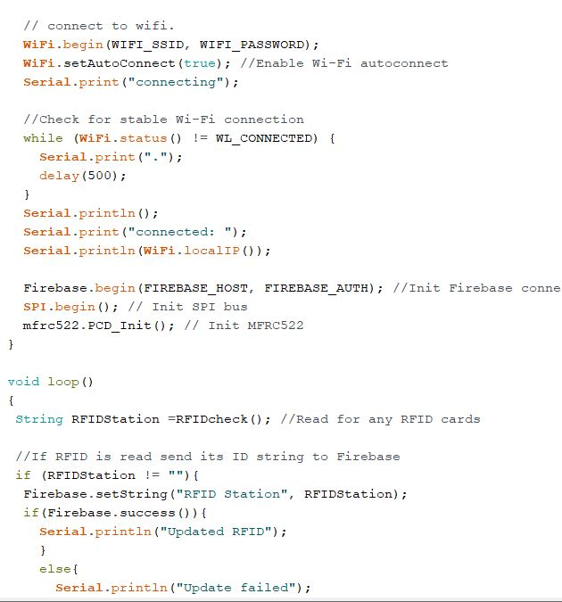
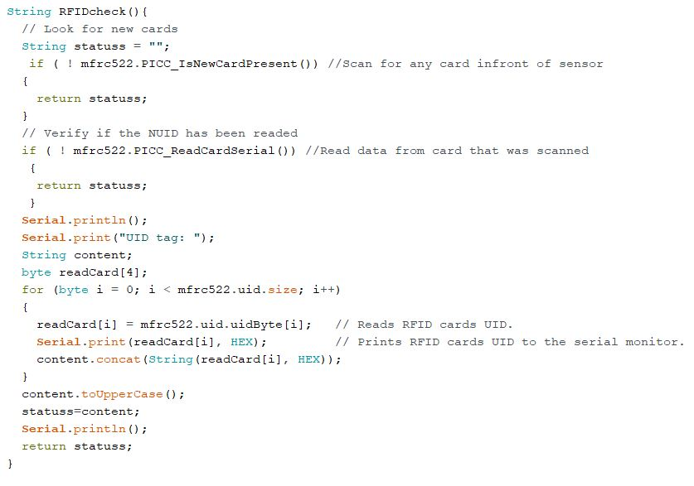
Software - Master
Notes:
Manish Balakrishnan

Slide 9
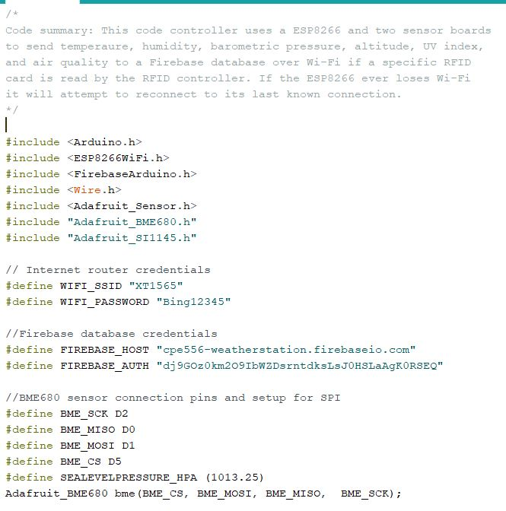
Software - Station 1
Slave ESP8266 programmed in Arduino IDE, using C++
Instantiates, WiFi & Firebase credentials and the sensors connected to it
Checks firebase to see if its station ID has been pinged
If pinged, it transmits sensor data to Firebase over WiFi
Notes:
Ryan Bloomgren

Slide 10
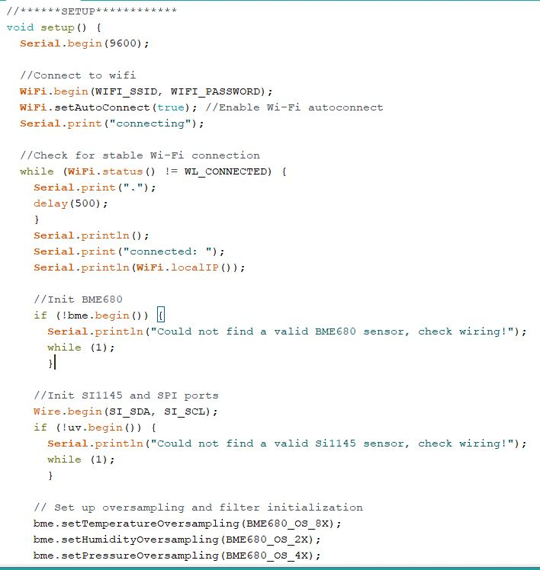
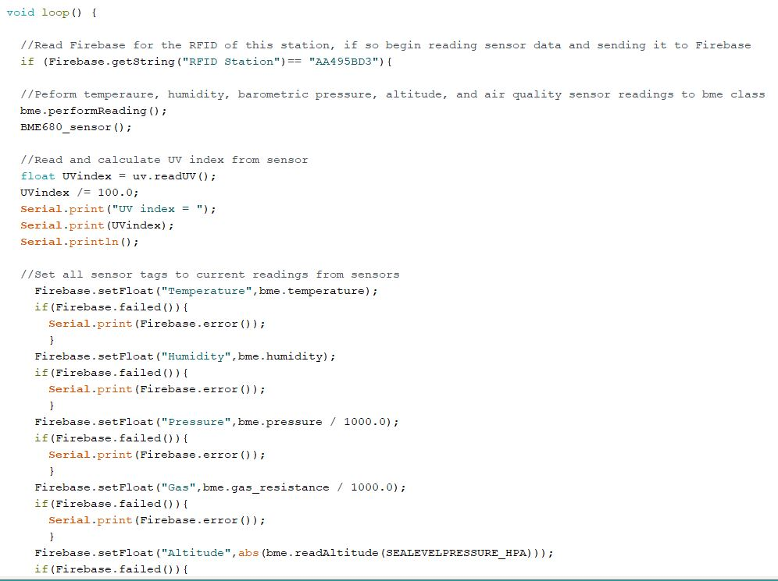
Software - Station 1
Notes:
Ryan Bloomgren

Slide 11
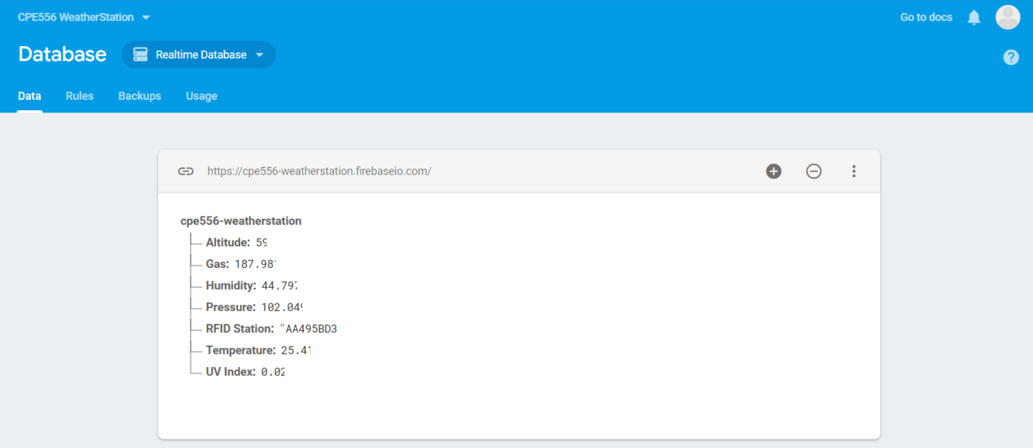
Firebase Database
Notes:
Ryan Bloomgren

Slide 12
Weather Station APP
Used MIT App Inventor 2 platform to build a mobile app to display data
Phone connects to Firebase and displays readings from the last RFID tag scanned
The phone’s back button resets all data in Firebase
Displays error message when unable to communicate correctly with Firebase
Notes:
Ryan Bajollari

Slide 13
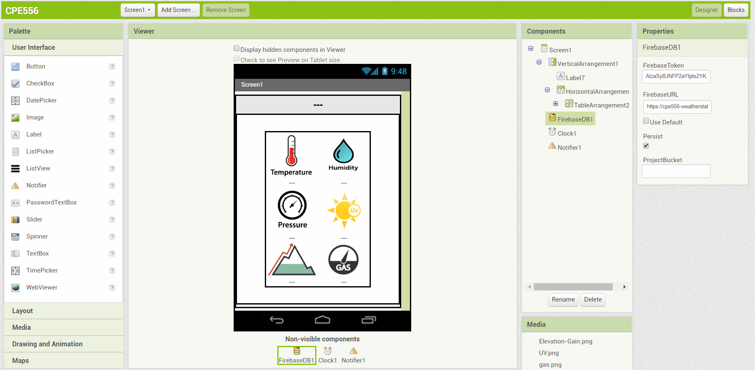
Weather Station App UI Design
Notes:
Ryan Bajollari
Mit App Inventor lets you create a mobile app quickly by picking and placing components

Slide 14
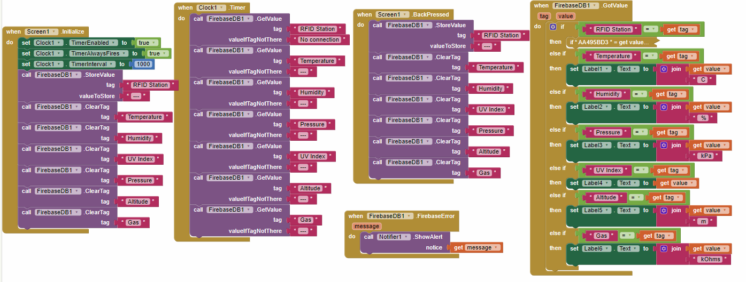
Weather Station App Block code overview
Notes:
Ryan Bajollari
Overview of all the code for the app

Slide 15
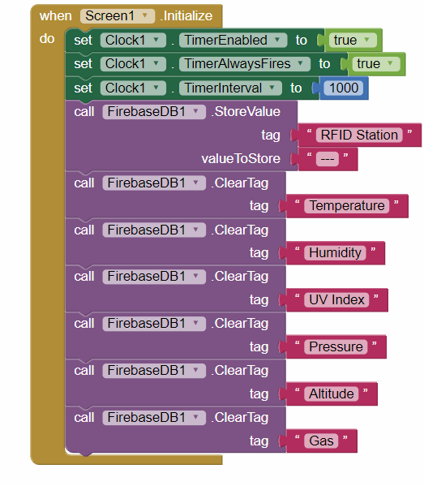
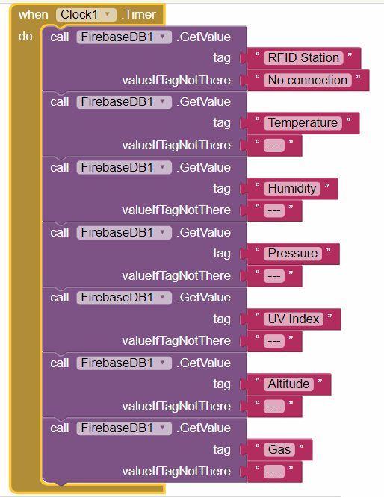
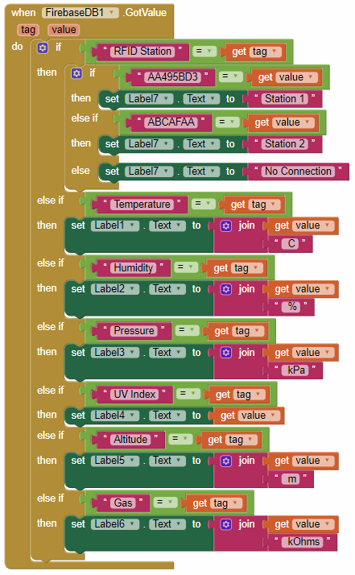
Weather Station App Block code
Notes:
Ryan Bajollari
First block - initializes the all the labels/variables in Firebase and sets them = 0
Second block - Every clock cycle(1s), checks firebase for values for each of the tags
Third block - when it gets value from firebase sets it to

Slide 16
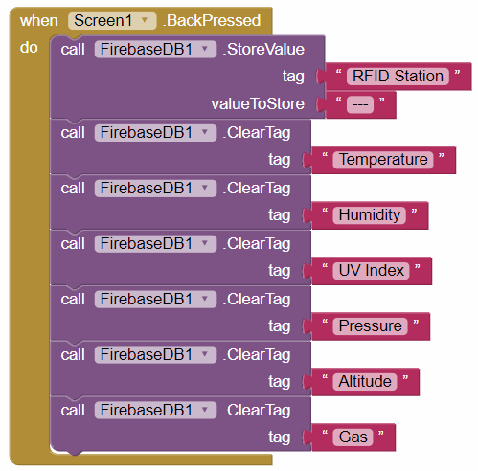
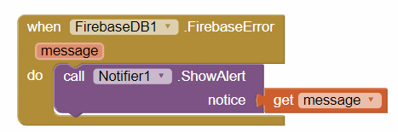
Weather Station App Block code
Notes:
Ryan Bajollari

Slide 17
Possible Future work
Add more stations to gather data from more locations
With more stations implement predictive algorithm to forecast future weather
Implement security protocol to stop man in the middle attacks from corrupting data
Design more robust UI for mobile app
Create webpage to view data on computers
Notes:
Ryan Bajollari

Slide 18
Demo

Slide 19
Questions?

